Slide 1




Welcome and Opening Remarks
Michael Watson
June 6, 2018
www.vita.virginia.gov
1

Slide 2
ISOAG June 6, 2018
Welcome & Opening Remarks Mike Watson, VITA
How to Manage Up Sherida Davis-Bryan, DOC
III. Multi-Sourcing Services Integrator Michael Fitch , Prentice Kinser &
Overview Grayson Walters, SAIC
IV. Upcoming Events Mike Watson, VITA
V. Operations Update NG

Slide 3
How to manage up
Sherida Davis-Bryan, MBA
June 6, 2018
Notes:
3 minutes
Thank you for coming today. I’m glad to be here and want to thank Joy Young for inviting me to speak to you.
I am SDB. I love to engage with managers and have had the pleasure of being a trainer about 5 years and a state employee for about 10.
I started reading about managing up in grad school and to this date I still find it a fascinating topic and a relevant one. I hope you will too.

Slide 4
Managing up:
I know my boss’ communication style. Yes No
I take problems to my boss before trying to solve them myself. Yes No
I bring problems to my boss with at least one solution. Yes No
I never bad mouth or embarrass my boss in front of others. Yes No
I ask my boss for help prioritizing work instead of saying no. Yes No
I know how and when to disagree with my boss. Yes No
Notes:
Before we get started. I’d like you to answer these questions and partner with someone else to review your answers. There are too many of you to hear the answers out loud.
Please don’t over think – it’s not meant to be deep or life changing – just a quick questionnaire.

Slide 5
Managing up:
I know my boss’ communication style. Yes No
I take problems to my boss before trying to solve them myself. Yes No
I bring problems to my boss with at least one solution. Yes No
I never bad mouth or embarrass my boss in front of others. Yes No
I ask my boss for help prioritizing work instead of saying no. Yes No
I know how and when to disagree with my boss. Yes No
Notes:
Before we get started. I’d like you to answer these questions and partner with someone else to review your answers. There are too many of you to hear the answers out loud.
Please don’t over think – it’s not meant to be deep or life changing – just a quick questionnaire.

Slide 6

What is managing up?
Notes:
Based on those questions and what you may already know--- what is managing up? Get a few answers.
Building smooth productive relationships with higher-ups.
What is managing up?
Define: It means being the most effective employee you can be, creating value for your boss and your company. That's why the best path to a healthy relationship begins and ends with doing your job, and doing it well. (Harvard business review)
Why is it important? What is the impact on your career?
What does it require? Understanding and adapting to your boss’ communication and decision making style.
Some may say it allows the by product of your effort to enhance the appearance of those you report to.

Slide 7
What is managing up?
Notes:
Based on those questions and what you may already know--- what is managing up? Get a few answers.
Building smooth productive relationships with higher-ups.
What is managing up?
Define: It means being the most effective employee you can be, creating value for your boss and your company. That's why the best path to a healthy relationship begins and ends with doing your job, and doing it well. (Harvard business review)
Why is it important? What is the impact on your career?
What does it require? Understanding and adapting to your boss’ communication and decision making style.
Some may say it allows the by product of your effort to enhance the appearance of those you report to.

Slide 8
Managing Up
Brand New
Remote Control
Insecure
All-knowing or Indecisive
Conflicting Message
Long-Winded
Hands-Off
Less than Sharp
Board of Directors
Notes:
Share these descriptions with the group.
The first person on that list is the manager that’s new to you
Remote control – someone who manages you from another site
Insecure – threatened by your presence
All knowing –
Insecure ---
Conflicting messages
Long winded
Hands off
Less than sharp (idiot?)
Board of directors – you report to a board

Slide 9
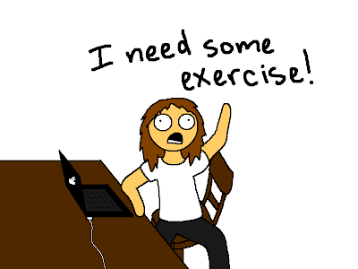
Why does this matter?
You
Agency
Boss
This Photo by Unknown Author is licensed under CC BY-NC-ND
Notes:
You and your boss are mutually dependent on each other.

Slide 10
Impact
Boss:
Needs are understood.
Decreased stress.
Positive image.
Less stress
More promotion options.
Builds better relationships.
You
Greater efficiency.
Organization
Better work product.
Positive image.
More effective teams or units.
Creates allies.
More confident in employee.
More latitude from manager.

Slide 11
What are some potential ways to manage up?
Communication – How? And When?
I’ve got problems and at least 1 solution.
Understand your boss’ personality and decision making style.
Know your boss’ priorities.
Know how your performance impacts your boss’ success.
Understand what motivates your boss?
Know your manager’s communication style.

Slide 12
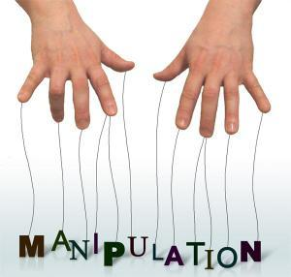

Managing up is NOT
This Photo by Unknown Author is licensed under CC BY-NC-ND
This Photo by Unknown Author is licensed under CC BY-SA
Notes:
Ask for examples
This is what happens when the focus moves from others – clients, your manager, the organization … to you
A misuse of the concept for self gain.

Slide 13
Avoiding the trap
Stay in your lane and do it well.
Become an indispensable solution to your manager’s problems.
Remember managers are NOT family.
Think of your manager as a client.

Slide 14
Cheat sheet
You Should: | When:
Engage | Yes
Collaborate | Yes
Challenge | When Needed
Advise | Where appropriate and you add value
Object | When it’s the right thing to do
Loyalty | Until it’s no longer earned
Manage | Never

Slide 15
resources
Disrupt Yourself Author: Whitney Johnson
42 Rules for Your New Leadership Role Author: Pam Fox Rolling
“The Right and Wrong Way to Manager At the Office” Wall Street Journal. Sue Shellenbarger. April 10, 2018.
“Managing Up Without Sucking Up” Harvard Business Review. Whitney Johnson. December 15, 2014.
“What Everyone Should Know About Managing Up.” Harvard Business Review. Dana Rousmaniere. January 23, 2015.
“My Advice On Managing Up – Don’t.” Forbes. Mike Myatt. November 30, 2012.
Notes:
How good people go bad…

Slide 16

Questions?
My contact info:
DOC: Sherida.Davis-Bryan@vadoc.virginia.gov

Slide 17

Information Security
Officer’s Advisory Group
MSI Overview
06 June 2018
Prepared for:

Slide 18
Agenda
Introductions
About SAIC (brief)
Multisourcing Services Integrator (MSI) – Key Features and Benefits
MSI – What’s New
Security Operations
Security Engineering and Cyber Risk Management

Slide 19
Introductions
Michael Fitch (CISSP-ISSMP) Account Manager
Grayson Walters (CISSP) Information Security Manager
Prentice Kinser (CISSP-ISSAP) Chief Security Architect

Slide 20
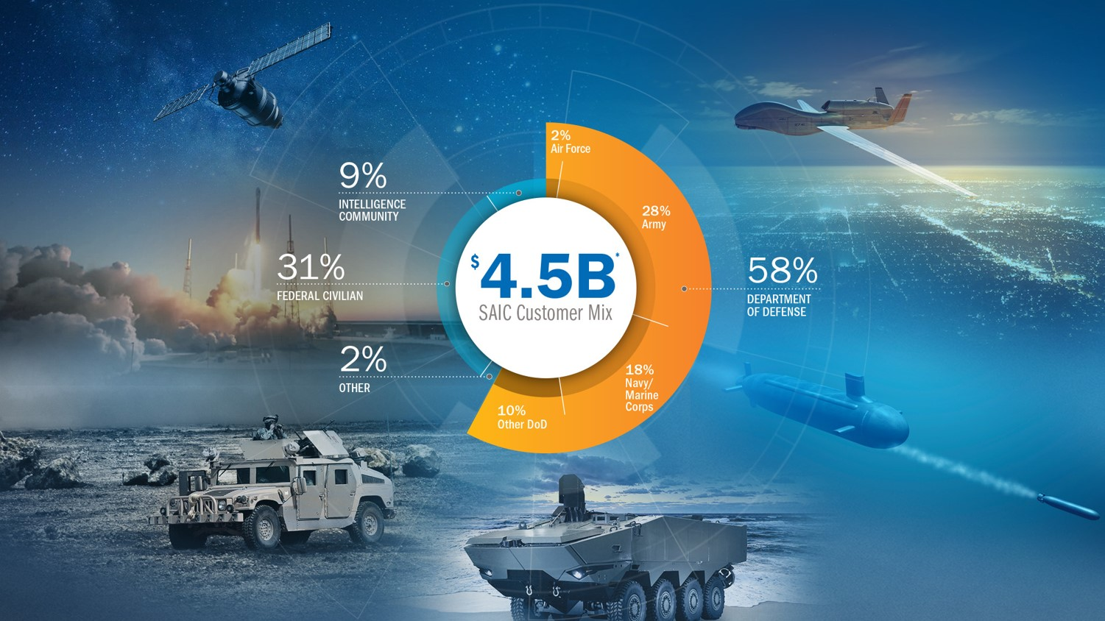
About SAIC - Overview

Slide 21
MSI Approach, Key Features and Benefits
Provide a Next-Generation Sourcing Model to provide the Commonwealth with Services now and with the ability to adapt in the future
Deliver a seamless Customer Experience across all providers and services
Enable and Manage Quality Services through understanding and meeting customer expectations; providing fast, visible and transparent services; and promote a positive, flexible attitude to support customer needs
Culture of Collaborative Performance – enabling others to be effective, efficient and successful
Provide a Marketplace of Choices enabling Service Tower Suppliers to easily and reliably move in and out of the model to provide customers access to technology and services aligned with business requirements

Slide 22






MSI Overview
Service Integration and Service Management
Focus on Meeting Needs & Expectations
Provides Seamless Service Delivery
Visibility at Every Level – Agency, Department, VITA, Enterprise
Integrations for Enablement:
  Technology (SMS)
  People (Org Alignment)
  Process (SMM)
Agencies of the Commonwealth
Integrated Service Delivery
Virginia Information Technologies Agency
Multisourcing Services Integrator (MSI)
Service Tower Supplier
Service Tower Supplier
Service Tower Supplier
Service Tower Supplier
Service Tower Supplier

Slide 23
MSI – What’s New
Business Relationship Management
Modernized Service Desk & Service Portal
Joint Operations Center
Security Operations
Project Office
Architecture, Strategy & Design
Full Service Portal
Communication
Security Incident Management
Program & Project Management
Technology Innovation
24x7 Support
Incident & Problem Management
Identity and Access Management
PMO
IT Roadmap, Strategy & Planning
Self-help and Training
Release Management
Assessments and Audit
Consolidated IT Financial Mgt
Cloud Brokerage for SaaS
Knowledge Management
Change Management
Supplier Management
Continual Service Improvement
Service Level Management
Service Asset and Configuration Management
Ongoing Programs
Cyber Security Risk Management
IT Service Continuity Management

Slide 24
Security Operations
Incident Response
Identity & Access Management
Security Clearance
Grayson Walters

Slide 25
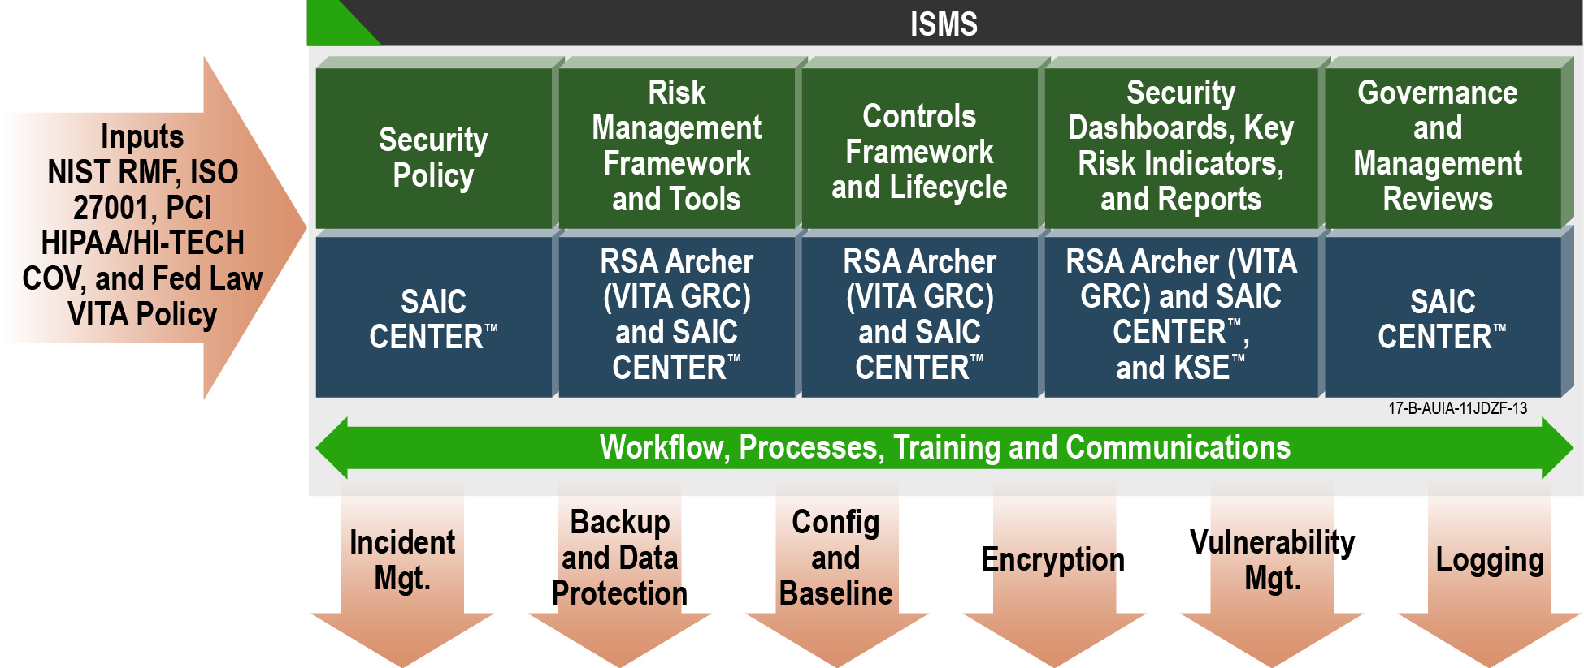
Information Security Management System Overview

Slide 26
Security Incident Response
VITA:
MSI (SAIC):
MSS (Atos):
Develops the IS-IMP (Information Security – Incident Management Plan
Documents the polices governing Security Incident Response across the Managed Environment
Operates under the IS-IMP to Provide Incident Response Investigations
Collect Logs, Alerts, and Events to Support the Investigation of Security Incidents
Implements tools to manage Security Incidents Across the Environment
Track and Record Security Incidents; working with service tower suppliers in the investigation and reporting of findings.
Conduct Forensic Investigations to Determine what Systems and Data are affected by the Security Incident.
Perform Forensic Collection of Evidence
Governance and Oversight
Coordinate investigation activities
Coordinate immediate response activities
Determine the Scope and Impact of Suspected Security Incidents
Identify Entry Points, Sources, Tools and Methods Employed by Intruders
Lead the Creation of Remediation Plans
Manage the execution of the approved remediation plans
Determine, Document, and Report Root Cause of Security Incidents
Work with MSI and Customer to Create Remediation Plans
Coordinate Routine Incident Response Exercises
Provide Recommended Improvements to VITA based on Exercises
Participate in the Routine Incident Response Exercises
Train Security Leads within the other Service Tower Providers to Ensure Ownership and Responsibility for Incident Handling
26
Notes:
Incident response coordination will be provided:
24 hours per day, 7 days per week (24x7)
Staffing will include dedicated security operations staff throughout the Business Day
On-call support for off-hours, holidays, and weekends

Slide 27
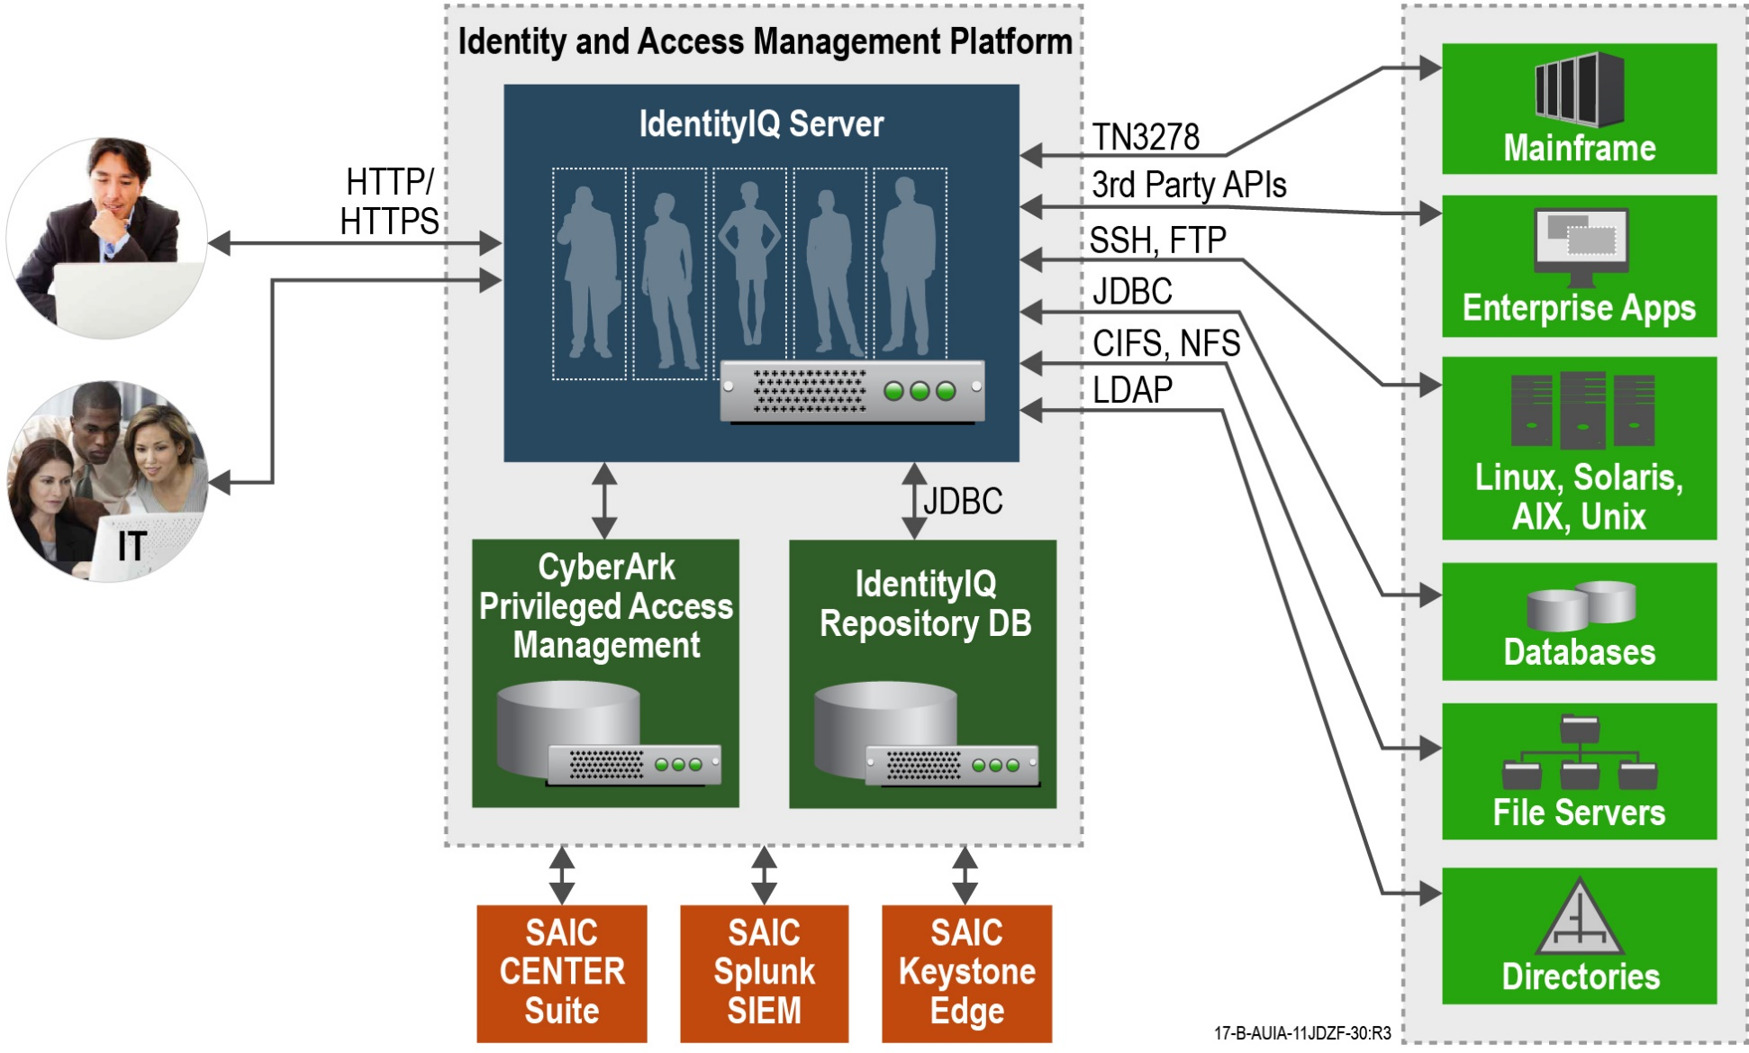
Identity Access Management / Identity Governance
Notes:
Managing Access
Changes to access can be initiated from the service portal.
Many types of access will be provisioned automatically upon completion of the request and approval process.
Notifications, audit logging, and compliance record retention occur as part of the workflow
Approved personnel will be able to pull live records from connected systems.

Slide 28
Security Operations
Providing Incident Management Tracking and Coordination
  Ongoing updates on the status of the incident, who is working the issue, and next steps.
Providing the Ability to Request Investigations, Security Scans, and Similar Activities
Maintain a single source of authority for security Incident information within Keystone Edge.
Ability to directly request security specific services and have those requests routed automatically for the most efficient service.

Slide 29
Security Engineering and Cyber Risk
Prentice Kinser

Slide 30
What is the Goal?
Controls Catalog: Hosted Environment Information Security Standard (SEC525) “Normal” and “Sensitive”
Controls Catalog: IT Information Security Standard (SEC501) “Normal” and “Sensitive”
Other Required Security Controls: HIPAA, FISMA, PCI, FTI (IRS 1075), Law Enforcement, etc.
Sub-Controls that CAN be Automated
Sub-Controls that CANNOT be Automated
Controls are implemented once for many to share!
Catalog of Inheritable Controls
Tower Supplier Automation RU’s that could be leveraged by COV customers
Tower Security Management Service RU’s that could be leveraged by COV

Slide 31
How does this benefit State Agencies?
Controls Catalog: Hosted Environment Information Security Standard (SEC525) “Normal” and “Sensitive”
Controls Catalog: IT Information Security Standard (SEC501) “Normal” and “Sensitive”
Other Required Security Controls: HIPAA, FISMA, PCI, FTI (IRS 1075), Law Enforcement, etc.
Security controls which would otherwise be a burden for the System Owner are on a menu of services
Controls WHICH THE SYSTEM OWNER NEEDS TO ADDRESS ON THEIR OWN
Sub-Controls that CAN be Automated
Sub-Controls that CANNOT be Automated
Controls are implemented once for many to share
Security controls which would otherwise be a burden for the System Owner are on a menu of services
Catalog of Inheritable SUB-Controls
Security controls which would otherwise be a burden for the System Owner are on a menu of services
Catalog of Inheritable SUB-Controls
Security controls which would otherwise be a burden for the System Owner are on a menu of services
HUGE LIST OF CONTROLS WHICH SYSTEM OWNER MUST FIGURE OUT HOW TO ADDRESS!

Slide 32
First Step: Catalog of “Success Recipes”
Hosted Environment Information Security Standard (SEC525-02):
1039 Security SubControls (AC, AT, AU, CA, CM, CP, IA, IR, MA, MP, PE, PL, PS, RA, SA, SC, SI)
GOAL: Catalog of Inheritable Controls, mapped to Success Recipes
Service Tower Suppliers:
Success Recipes
Identify SEC525 sub-control
Identify an STS service that supports this sub-control
Recipe #1
Identify a recipe that enables successful usage of this service
Recipe #2
RU
RU
RU
Recipe #3
RU
• • •
Service Tower Suppliers:
Services (from VITA Requirements and STS Proposals)
Recipe #N

Slide 33
Success Recipe Example
Hosted Environment Information Security Standard (SEC525-02):
  AC-6(1) Explicitly authorize access to organization-defined security functions
  AC-6(2) Use non-privileged accounts to access non-security functions
  AC-6(5) Restrict privileged accounts to specific personnel
  AC-6(6) Prohibits privileged access to the information system by non-organizational users
  AC-6(7) Periodic review of Administrator privileges
  AC-6(9) Audit the execution of privileged functions
  AC-6(10) Prevent non-privileged users from executing privileged functions
Catalog of Inheritable Controls, mapped to Success Recipes
AC-6 (incl. enhancements for Sensitive Systems)
MSI Service Tower:
Success Recipes
CyberArk Appliance
Require administrators to access via CyberArk
Recipe: CyberArk for Admin Access
Requires the following MSI RU(s):…
For all assets in accreditation boundary, CyberArk must control all administrator access
All administrators must have a credential for normal non-admin activities, and also have a 2FA credential for CyberArk access
MSI will periodically report Administrator activities to reliant organization for their review
Multi-Sourcing Integrator (MSI):
Multi-Sourcing Integrator (MSI):
  R1765. Provide notification of suspicious or malicious account activity to the designated parties included in the SMM immediately upon discovery
  R1767. Provide capability to manage accounts (e.g. individually and in mass, provision, reactivate, modify, de-provision, suspend, etc.) in order to govern access.
  R1772. Provide Customers with the capability to exercise authority for approval of all data and System access requirements.
  R1775. Provide the capability to manage privileged accounts.
  R1781. Provide the capability to log all system activity and generate custom reports using this data.

Slide 34

Important Considerations for Success Recipes
The System Owner will inherit compliance if and when:
  System Owner implements the “Success Recipe”, and
  System Owner addresses the control dependencies which are documented in a Customer Responsibilities Matrix
Good “Success Recipes” address multiple security controls
Great “Success Recipes” exhibit pervasive automation: SMS, Chef, Ansible, Puppet, Jenkins, etc.
(more automation + less paperwork = maturity)
Reliant Parties (System Owners) will use the Catalog of Inheritable Controls as a tool to determine what RU’s are available to help them comply with which security controls
Auditors will assess Information Systems for correct implementation of “Success Recipes” as part of their determination of compliance with security controls

Slide 35
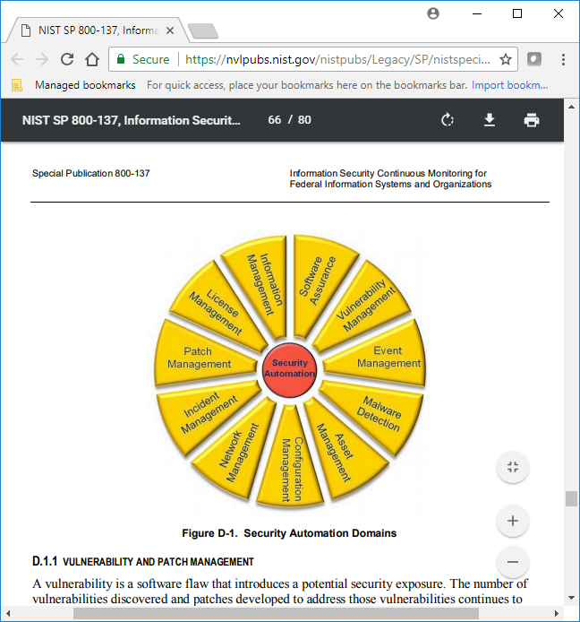
Scope: NIST SP800-137 Information Security Continuous Monitoring
Hosted Environment Information Security Standard (SEC525-02):
1039 Security SubControls (AC, AT, AU, CA, CM, CP, IA, IR, MA, MP, PE, PL, PS, RA, SA, SC, SI)
These are the Control Families most amenable to Automation, and therefore Inheritance between Towers

Slide 36
Thank you!
For further information please contact:
Michael S. Fitch | PgMP®, CISSP-ISSMP®
Program Management Director | Federal Civilian Agencies
tel: 401/408-4843 | mob: 415/609-8850
Grayson Walters | CISSP®
Information Security Manager | Federal Civilian Agencies
tel: 804/273-8522
Prentice Kinser| CISSP-ISSAP®
Chief Security Architect | Federal Civilian Agencies
tel: 703/399-5217

Slide 37
Upcoming Events
www.vita.virginia.gov
37

Slide 38
Future ISOAG
July 11, 2018 @ CESC 1:00-4:00
Speakers: Elliott Casey, Commonwealth’s Attorney’s Services Council
&
Bill Stewart, VITA
ISOAG meets the 1st Wednesday of each month in 2018

Slide 39
IS Orientation
When: Thursday , June 7, 2018
Time: 9:00 –11:00 am
Where: CESC , Room 1221
Presenter: Ed Miller
Register here:
http://vita2.virginia.gov/registration/Session.cfm?MeetingID=10
ISOAG meets the 1st Wednesday of each month in 2018

Slide 40
MS ISAC Poster Contest National Winner
MS ISAC selected a Virginia poster as the national winner of the 2018 MS ISAC Poster Contest. The poster will be displayed on the cover of the 2019 “Kids Safe Online” calendar which will be distributed to all 50 states.
Winner: Sergio
School: Potomac Senior High School
Dumfries, Va

Slide 41
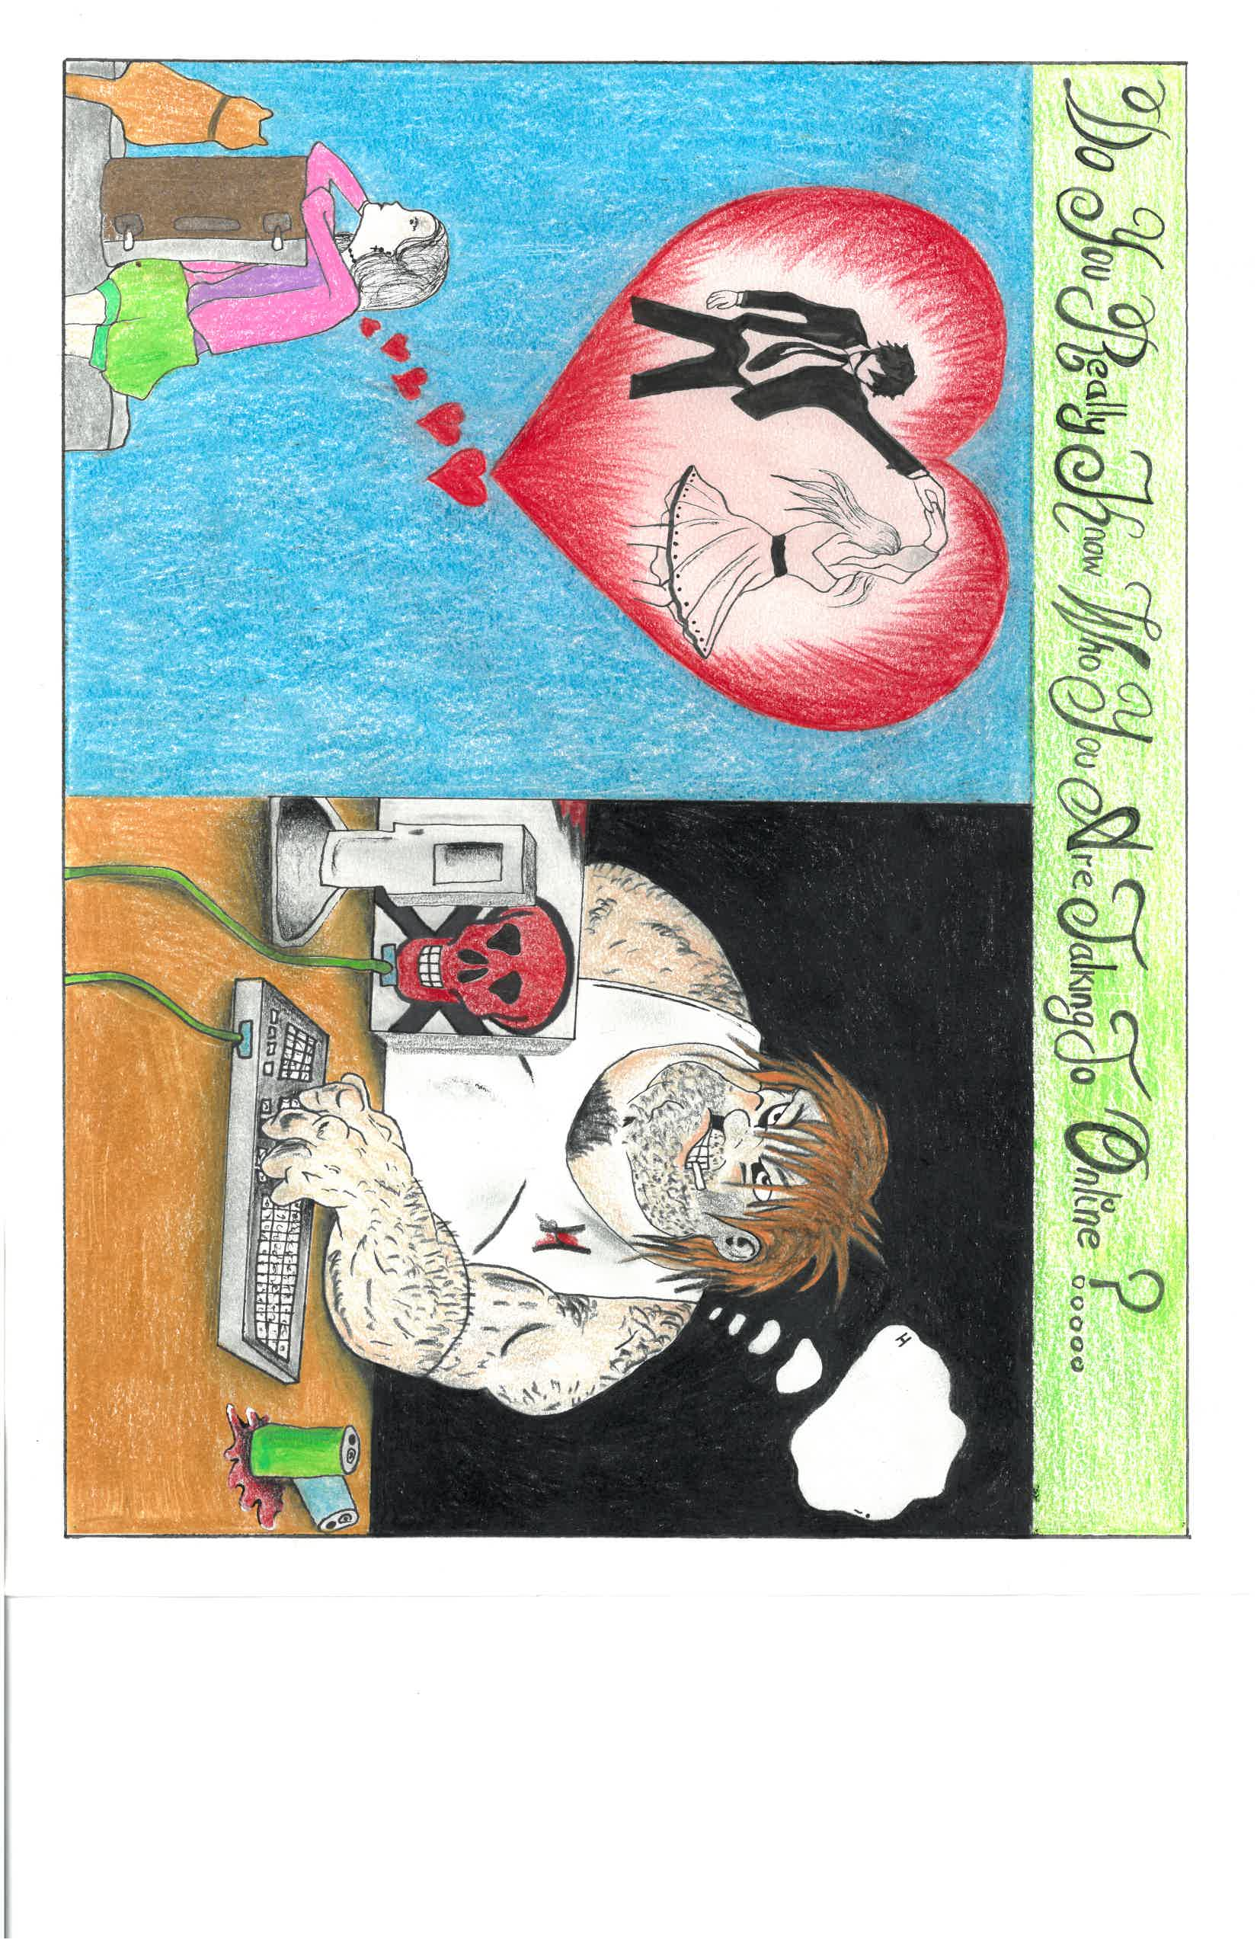
MS ISAC Poster Contest National Winner

Slide 42

ADJOURN
THANK YOU FOR ATTENDING
Picture courtesy of www.v3.co.uk

